Slide 1
Tour and Travel Information System (Enjoy.in)
161111030 Bimo Prakoso
161111044 Hizkia Luke S
161111067 Muhamad Irfan Zidni
161111078 Bibie Hadi Kusuma

Slide 2
Loop Inc
Loop Inc is a Software Development Company based in Malang-Indonesia, with almost 2 years of successful experience.
We provide a variety of services to our clients, including Custom Software Development, Data Migration and Integration, Web Services, as well as Network and System Administration.
Our Company vision is to be a one-stop software partner for our global clients while maintaining an open-minded, dynamic, and customer-centric approach to delivering cutting-edge solutions.

Slide 3









Our Specialist

Slide 4





In Number
2016
Year established
11
Projects completed successfully
3
Projects running in 2018
100
Highest project value (in million IDR)
4
Initial team members in

Slide 5
3 Running Projects in 2018
Tour and Travel Information System (Enjoy.in)
Restaurant Information System (Lazzis)
Website Phishing Classifier

Slide 6
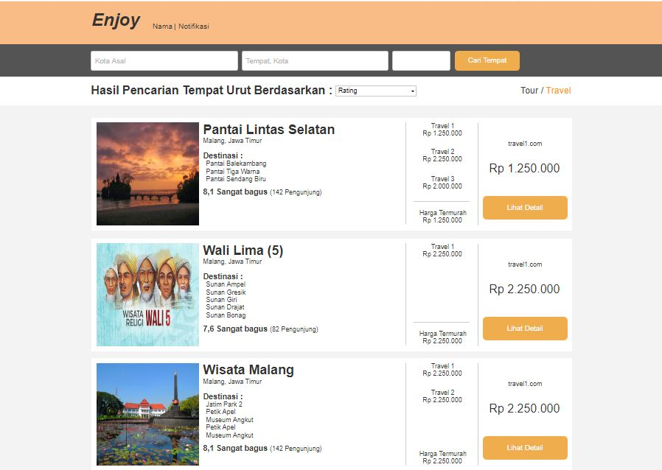
Enjoy.in

Slide 7
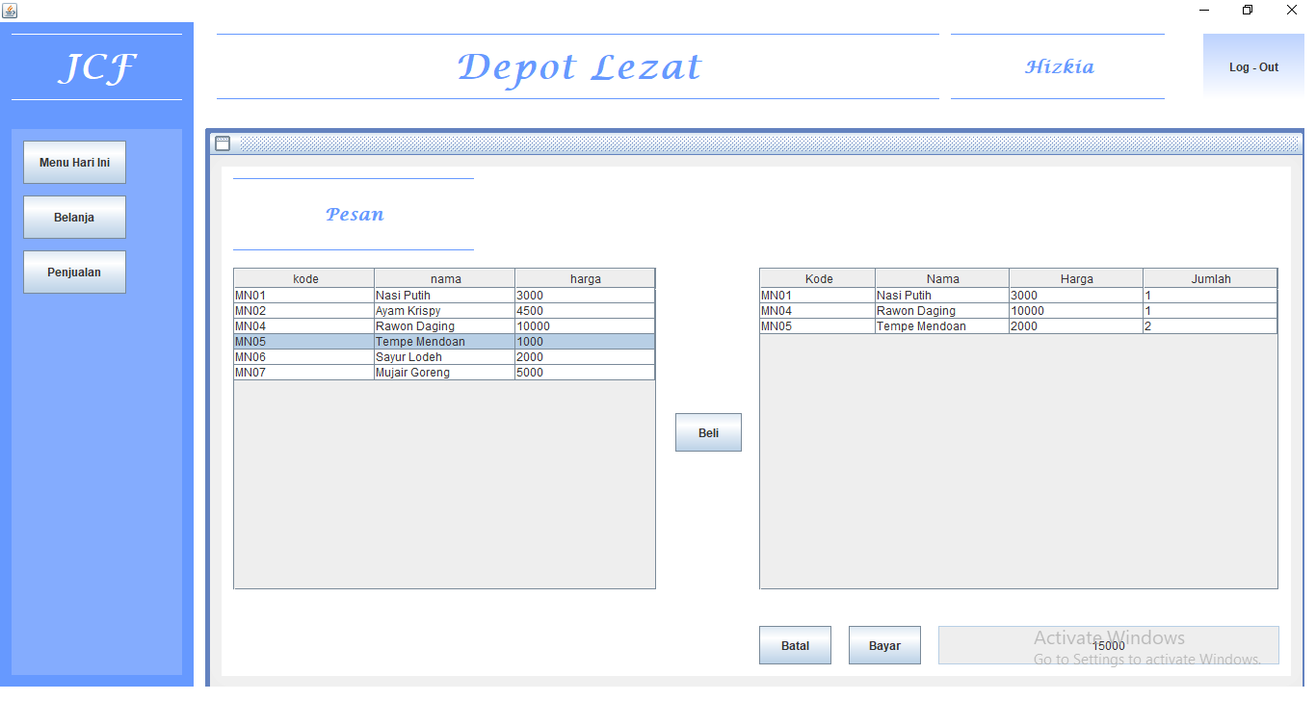
Lazzis Information System

Slide 8
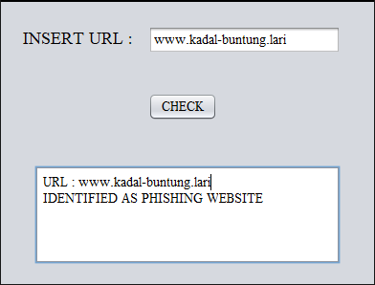
Website Phishing Classifier

Slide 9
Organization Structure
Project Manager
(Hizkia Luke S.)
System Analyst
(Bibie Hadi K.)
Developer
Quality Control
(Bimo Prakoso)
Back-end Designer
(Bibie Hadi S. & Bimo Prakoso)
Front-end Designer
(M. Irfan Zidni)

Slide 10
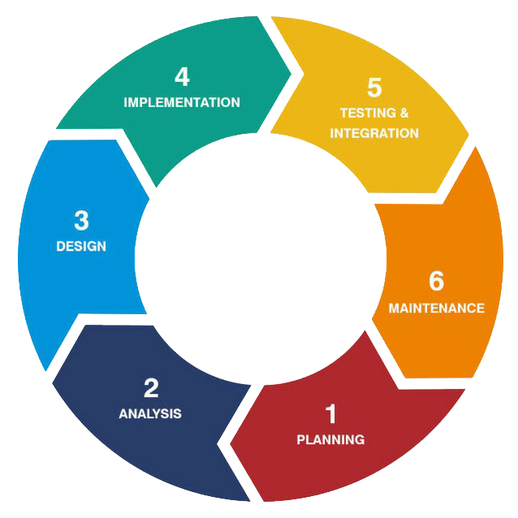
Flow

Slide 11
Project Resources and Timeframe
Timeframe
- 20 Week
- Details proposed as seen on project timeline
- Team in Malang
Project Resources
Back-end Developer
Front-end Developer
Project Manager
Quality Control
System Analyst
83
33
109
12
10

Slide 12
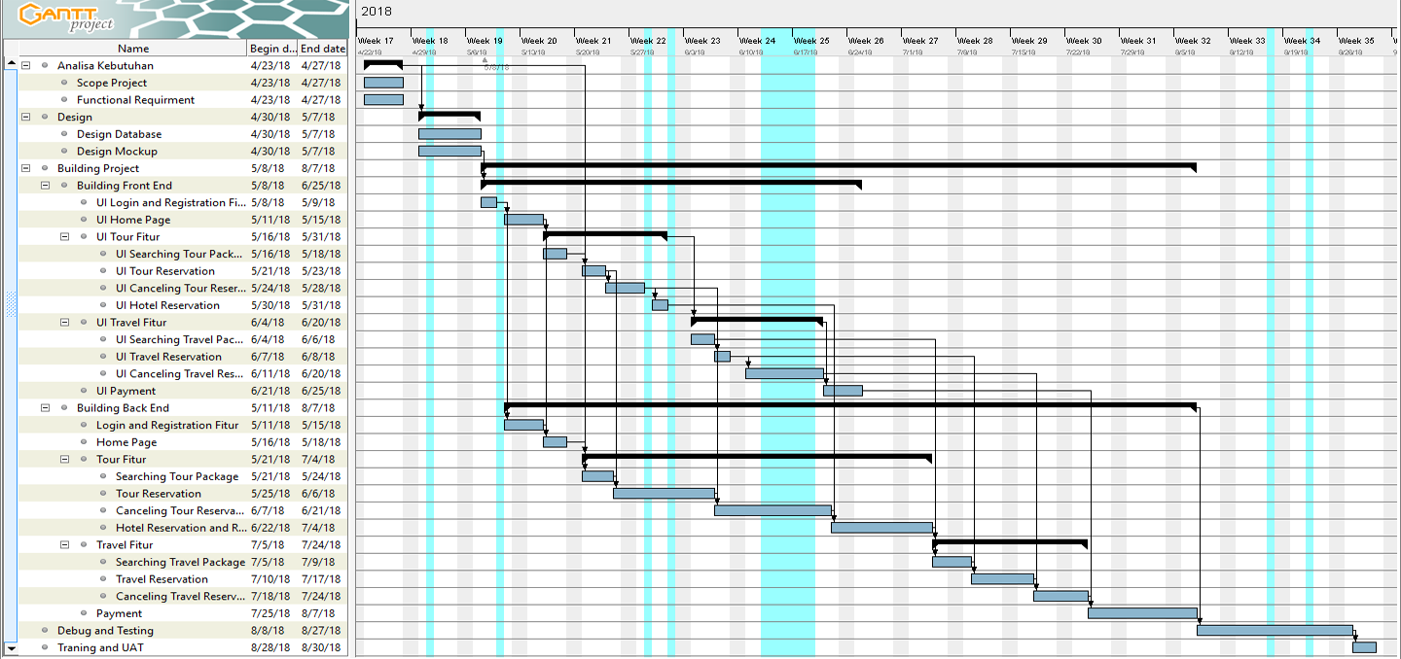
Project TimeLine
23 – 27 April 2018 : Requirements Analysis
30 April – 7 May 2018 : Design
8 May – 7 August 2018 : Building Project
8 August – 27 August 2018 : Debug and Testing

Slide 13
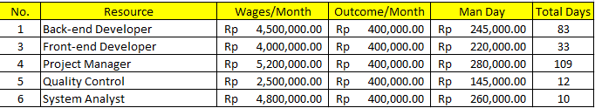
Man Days

Slide 14
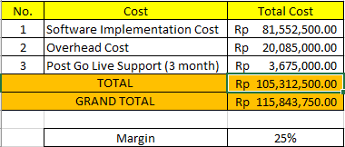
Project Budget and Margin

Slide 15
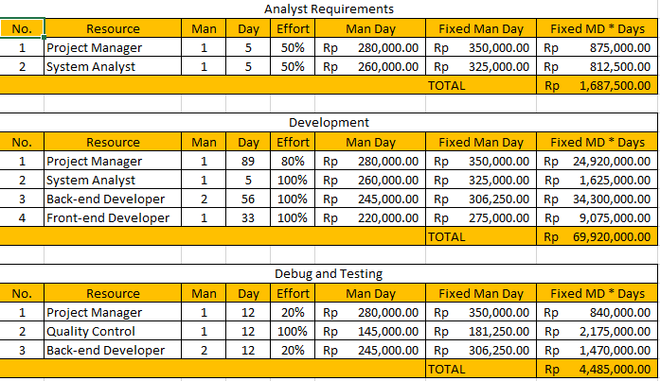
Software Implementation Cost

Slide 16
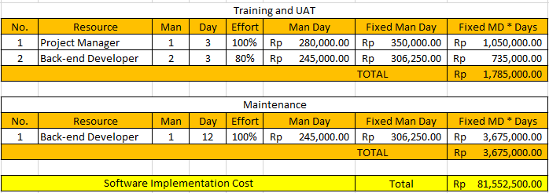

Slide 17
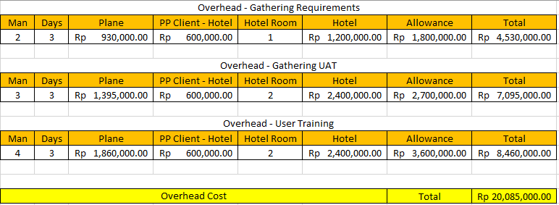
Overhead Cost

